Slide 1
Vector Tiles Western Maryland User Group Meeting
Patrick Hammons

Slide 2
Introducing Vector Tiles

Slide 3
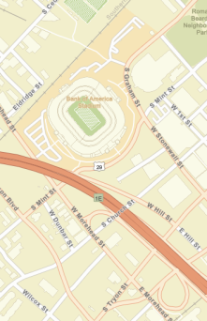
What are Esri Vector Tile Basemaps?
Introduction
Basemaps cached and delivered as vector tiles (PBF format)
Rendered client-side
Based on a set of resource files delivered with vector tiles
Styles (root.json)
Sprites (patterns & symbols)
Fonts
Info (font & sprite file list)
Vector Tiles: Western Maryland User Group Meeting
Notes:
Protocol Buffer Format

Slide 4





What are Esri Vector Tile Basemaps?
Introduction (continued)
Esri generating with development versions of ArcGIS Pro
Vector basemaps display in most current desktop web browsers
Future plans to display the maps in various desktop and mobile apps
Vector Tiles: Western Maryland User Group Meeting

Slide 5




RASTER
Multiple sets of cache
Set for each different map style
Cached at multiple scales
Each set multiple terabytes in size
Commercial Data
HERE
ArcGIS Server
Community Data
Contributions
Single Tile Set
Scalable
Gigabytes in size
VECTOR
ArcGIS Pro
Open Source Data
OpenStreetMap
Separate resource files for each style
Megabytes in size
Vector Tiles: Western Maryland User Group Meeting

Slide 6
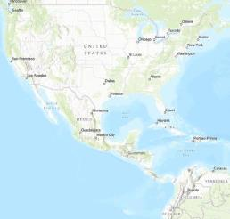
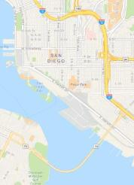
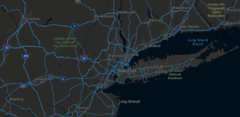
What are Esri Vector Tile Basemaps?
Introduction (continued)
Some styles closely resemble existing Esri basemaps
Streets (with / without relief)
Topographic
Light Gray Canvas
Dark Gray Canvas
Terrain with Labels
Other styles are new
Navigation
Streets at Night
Imagery Hybrid
Vector Tiles: Western Maryland User Group Meeting

Slide 7
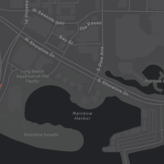
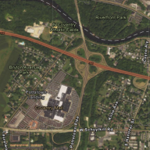

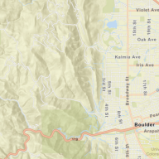
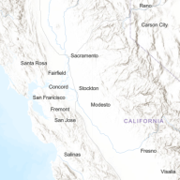
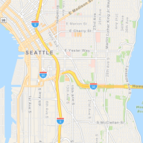
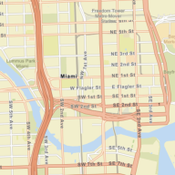
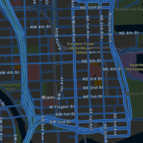
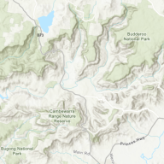
What are Esri Vector Tile Basemaps?
Introduction (continued)
Initial set includes nine different map styles
All built from a single vector tile service
Vector Tiles: Western Maryland User Group Meeting

Slide 8


What are Esri Vector Tile Basemaps?
Introduction (continued)
Availability
Tile layers
Add to existing maps either as basemap or overlay layer
Web maps
Use as basemap for adding other layers
Vector Tiles: Western Maryland User Group Meeting

Slide 9
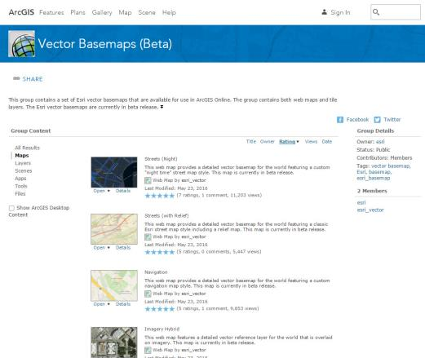
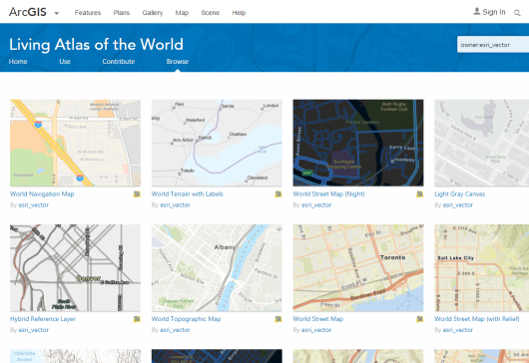
Where can I find Esri Vector Tile Basemaps?
ArcGIS Online
Vector Basemaps (Beta) group
Web maps & Tile layers
Review online items & descriptions
Bookmark it!
Search in Living Atlas & ArcGIS Online
owner:esri_vector

Slide 10
Esri Vector Tile Basemaps
Beta 2.x releases throughout 2016
Continue data updates at shorter intervals
Settings file refinements
Style improvements & more data features
Update Esri basemap tile layers & web maps
Timeline
Initial showing at U.C. 2015
Beta 1 release November 2015
2015
2016
Beta 2 release May 2016
New tile set & URL
Updated root.json syntax
New data features added
Updated data & new communities added
2017
Vector Tiles: Western Maryland User Group Meeting

Slide 11
Esri Vector Tile Basemaps
Timeline (continued)
Exiting Beta
Planned for later in 2016
JavaScript API improvements for better map display
Current limitation (some labels clipped at edge of tiles)
As more Esri clients utilize the vector tile format
Survey123, Collector, Workforce, Explorer for ArcGIS, Pro 1.3+
Vector Tiles: Western Maryland User Group Meeting

Slide 12
Future Enhancements
Esri Vector Tile Basemaps
Additional contributor data & commercial content from HERE
Better mapping content updated on a more frequent cycle
More data features
Spot elevations
Landform labels
Contours
Community sourced roads
User choices how to customize layers
… and more to come
Vector Tiles: Western Maryland User Group Meeting

Slide 13
Benefits of using
Esri Vector Tile Basemaps
Updated Data cooked into single tile set
Faster release time
Map Style Customization
Better display on High-res devices
Vector Tiles: Western Maryland User Group Meeting

Slide 14
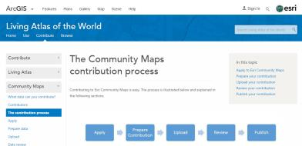
Updated Data in the Esri Vector Tile Basemaps
Benefit
Commercial data updates
Esri Community Maps data updates
More than 400 contributors… and growing!
Country-level to campus detail
Reducing time from data submission to release in vector tiles
Data cooked into single vector tile set & available in all styles
Vector Tiles: Western Maryland User Group Meeting

Slide 15
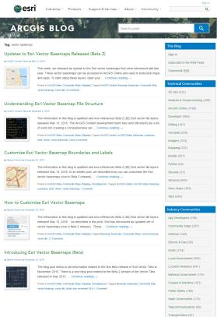
Create Custom Styles from Esri Vector Tile Basemaps
Benefit
Esri Vector Tile Basemaps Data and Style Updates
Updates to Esri Vector Basemaps Released (Beta 2)
Understanding Esri Vector Basemap File Structure
Customize Esri Vector Basemap Boundaries and Labels
How to Customize Esri Vector Basemaps
Introducing Esri Vector Basemaps (Beta)
Blogs.esri.com
Tag: vector basemap
Vector Tiles: Western Maryland User Group Meeting

Slide 16
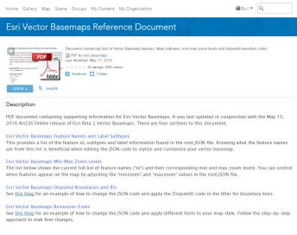
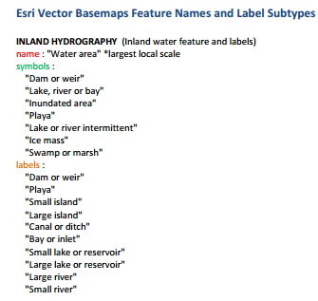
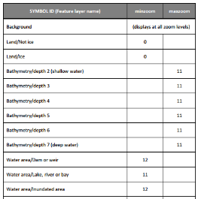
Create Custom Styles from Esri Vector Tile Basemaps
Benefit (continued)
Esri Vector Basemap Reference Document
PDF document available at ArcGIS.com
Layer detail, min/max zoom levels, fonts, & more…
Vector Tiles: Western Maryland User Group Meeting

Slide 17
Create Custom Styles from Esri Vector Tile Basemaps
Benefit (continued)
Serving a single vector tile set
Multiple styles available as starting point for customization
Save a copy of vector tile basemap layer into your own ArcGIS Online account
Different ways to re-style & customize the maps
Styling apps, direct json editing, or with JavaScript API
Vector Tiles: Western Maryland User Group Meeting

Slide 18
http://bit.ly/VectorTileGUI

Slide 19
Thanks!
Want more? Check out: http://bit.ly/WMUG-vector-more
phammons@esri.com

